Slide 1
Targeted Agents – Future Prospects, Including Combination Strategies, in Ovarian Cancer
Stanley B. Kaye, MD
Royal Marsden Hospital
London, United Kingdom

Slide 2
Progress in the Management of Ovarian Cancer: Evolution Over 40 Years
Five-year survival
15%
30%
40%
?50%?
First use of oral PARPi
Key advances in chemo-therapy
Positive evidence
for weekly paclitaxel in first line
First use
of
cisplatin
First use
of
carboplatin
First use
of
Paclitaxel
First reports
of
bevacizumab
1970
1980
1990
2000
2010
Standard of care (first line): paclitaxel/carboplatin
Median progression-free survival / overall survival is approximately
12-20 m/3-5 years.
Q. How can we do better?
A. Rational molecular targeted therapy

Slide 3
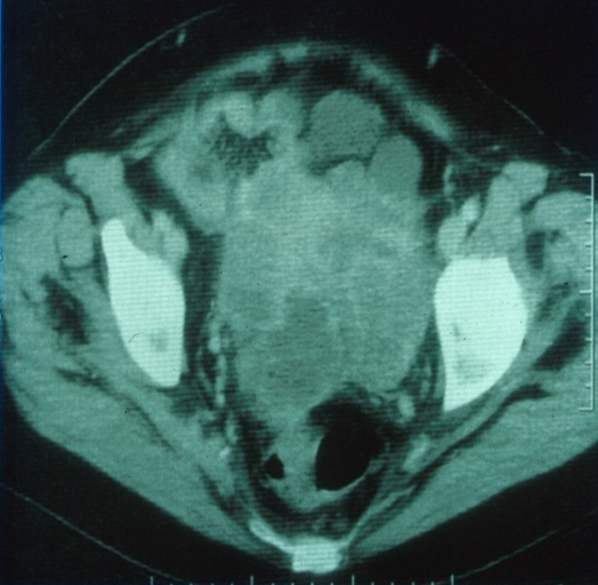
Rational Targets in Ovarian Cancer –Agents Now in the Clinic
Inhibitors of:
VEGF and other angiogenic factors
PARP
P13K/AKT
MEK
2015 update on:
Single-agent data
Combination strategies

Slide 4
Single Agents
Antiangiogenic Agents
PARP Inhibitors
Bevacizumab
VEGFR /TKIs
cediranib
pazopanib
nintedanib
Ang1/Ang2
trebananib
Antivascular
fosbretabulin
Olaparib
Niraparib
Rucaparib
What can we conclude from randomised trials so far?

Slide 5
Image not available

Slide 6
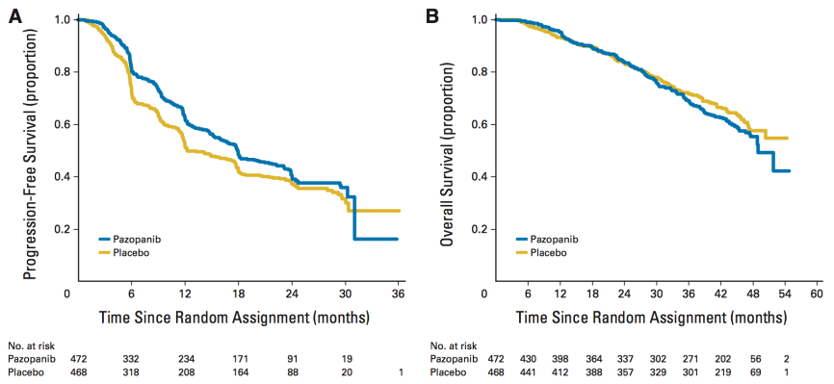
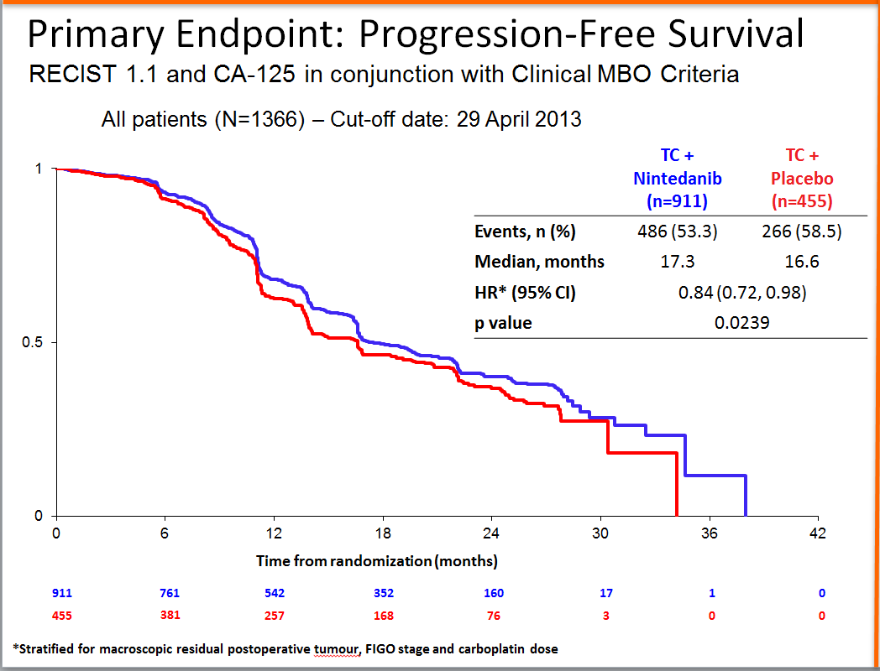
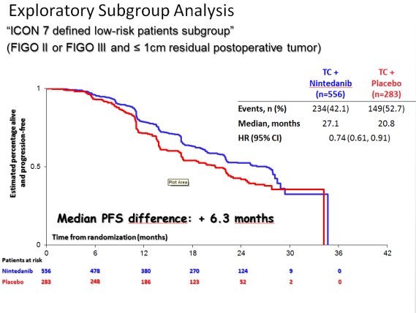
Single-Agent Trials – Antiangiogenic Agents
First Line (cont)
AGO-OVAR 16: DuBois A, et al. J Clin Oncol. 2014;32(30):3374-3382.
Pazopanib (AGO-OVAR 16, n = 940)
maintenance only
HR 0.77 for PFS benefit
significant toxicity at 800 mg bd (<50% patients received 12 months therapy)
no overall survival benefit
not being pursued in first line
AGO-OVAR 12: DuBois A, et al. Int J Gynecol Cancer. 2013;23(8suppl1): Abstract LBA1.
Nintedanib (AGO-OVAR 12, n = 1366)
concurrent and maintenance
modest PFS benefit (HR 0.84), best seen in “low-risk” patients
further plans for first line studies unclear

Slide 7
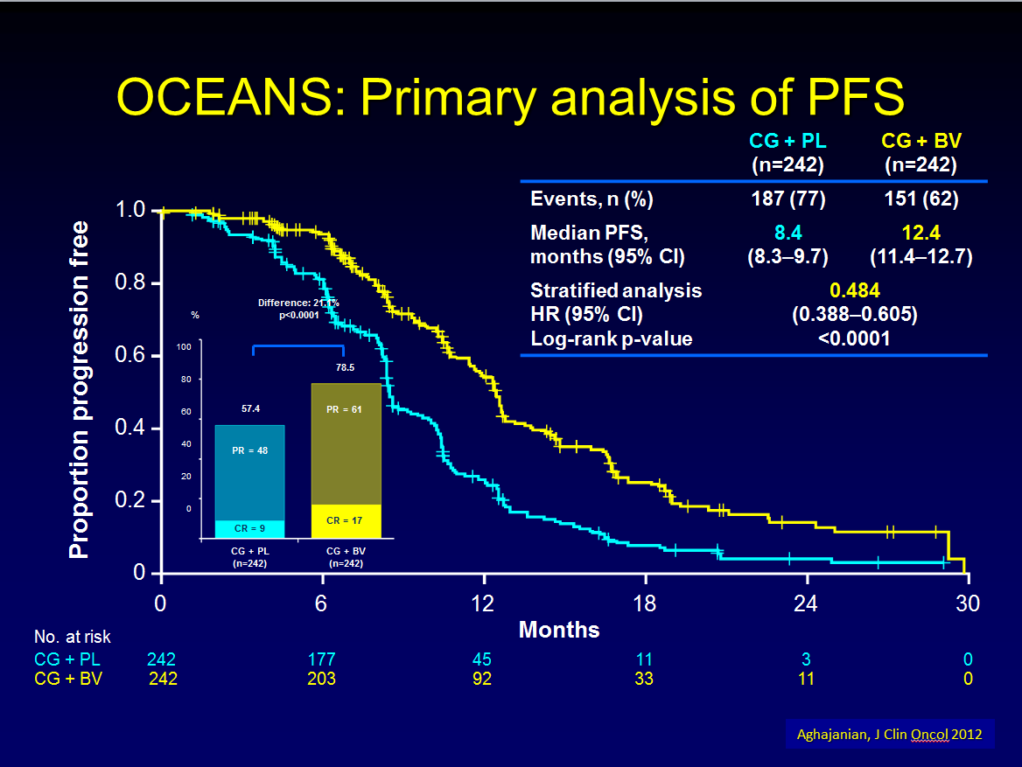
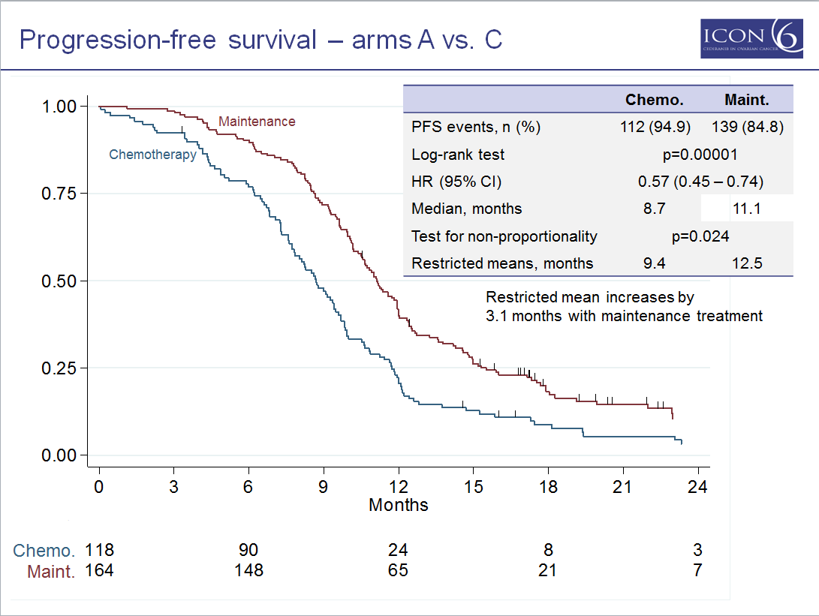
Single-Agent Trial – Antiangiogenic Agents
Second Line (platinum sensitive)
Bevacizumab (OCEANS)
As concurrent and maintenance, PFS benefit, HR = 0.48
May be preferred option for patients optimally debulked at initial surgery
Aghajanian C, et al. J Clin Oncol. 2012;30(17):2039-2045.
Cediranib (ICON6)
As concurrent and maintenance, similar PFS benefit to OCEANS (HR of 0.57) with trend to OS benefit (HR 0.75)
Would efficacy be retained in patients previously treated with bevacizumab?
Ledermann JA, et al. Eur J Cancer. 2013;49(Suppl 3): Abstract LBA10.
Open questions:
Is there a rational patient selection strategy, eg, genomic profile
What about patients with BRCA mutations?
What is the impact of prior antiangiogenic treatment?

Slide 8
Single-Agent Trials – Antiangiogenic Agents
Platinum-Resistant Disease
Assume standard treatment is weekly paclitaxel
Is there any evidence of survival benefit?
Which would you choose?
What is the impact of prior antiangiogenic treatment?
Bevacizumab (AURELIA, n = 115)¹
median PFS 3.9 m -> 10.4 m
Trebaninib (TRINOVA-1, n = 919)²
median PFS 5.4 m -> 7.2 m
Pazopanib (MITO 11, n = 74)³
median PFS 3.5 m -> 6.3 m
1. Pujade-Lauraine E, et al. J Clin Oncol. 2014;32(13):1302-1308.
2. Monk BJ, et al. Lancet Oncol. 2014;15(8):799-808.
3. Pignata S, et al. J Clin Oncol. 2014;32(5S): Abstract 5503.

Slide 9
Summary of PFS and OS in AURELIA Trial
 | PAC | PAC-B | PLD | PLD-B | TOPO | TOPO-B
PFS (m) | 3.9 | 10.4 | 3.5 | 5.4 | 2.1 | 5.8
HR | 0.46 (0.3-0.71) |  | 0.57 (0.39-0.83) |  | 0.32 (0.21-0.49)
OS (m) | 13.2 | 22.4 | 13.7 | 14.1 | 13.3 | 13.8
HR | 0.65 (0.42-1.02) |  | 0.91 (0.62-1.36) |  | 1.09 (0.72-1.67)
PAC, Paclitaxel
PLD, Pegylated liposomal doxorubicin
TOPO, Topotecan
Best results seen with paclitaxel
Poveda AM, et al. Ann Oncol. 2012;23(Suppl 9): Abstract LBA26.
Witteveen P, et al. Presented at ESGO 2013.
Pujade-Lauraine E, et al. J Clin Oncol. 2014;32(13):1302-1308.

Slide 10
Antiangiogenic Inhibitors in 2015
Issues: what if the patient has a BRCA mutation?
She should receive maintenance PARP inhibitor at some point, either before or after antiangiogenic, depending on regulatory environment
Will a combination be more appropriate? (eg, olaparib/cediranib)

Slide 11
Impact of Prior Antiangiogenic on Repeat Antiangiogenic Therapy
Published / presented data very limited
Total around 100 cases previously treated with bevacizumab (or other antiangiogenic)
Includes:
TRINOVA I – up to 72, (where addition of trebaninib to weekly taxol still carried some (not significant) PFS benefit in patients previously treated with bevacizumab).
AURELIA – 26 (numbers too small to draw conclusion)
PHASE II trials of TKIs, inhibiting VEGFR, FGFR, etc,
eg, brivanib where n = 25 for prior antiangiogenic – response rate 23% in this subgroup.
Therefore, more data needed!
Is it appropriate to give bevacizumab more than once? – in my view, not until clinical data support this
Monk BJ, et al. Lancet Oncol. 2014;15(8):799-808.
Pujade-Lauraine E, et al. J Clin Oncol. 2014;32(13):1302-1306.
Kaye S, et al. Ann Oncol. 2012;23(Suppl 9): Abstract 9660.

Slide 12
Rational Targets in Ovarian Cancer - Agents Now in the Clinic
Inhibitors of:
VEGF and other angiogenic factors
PARP
P13K/AKT
MEK
2015 update on:
Single-agent data
Combination strategies

Slide 13
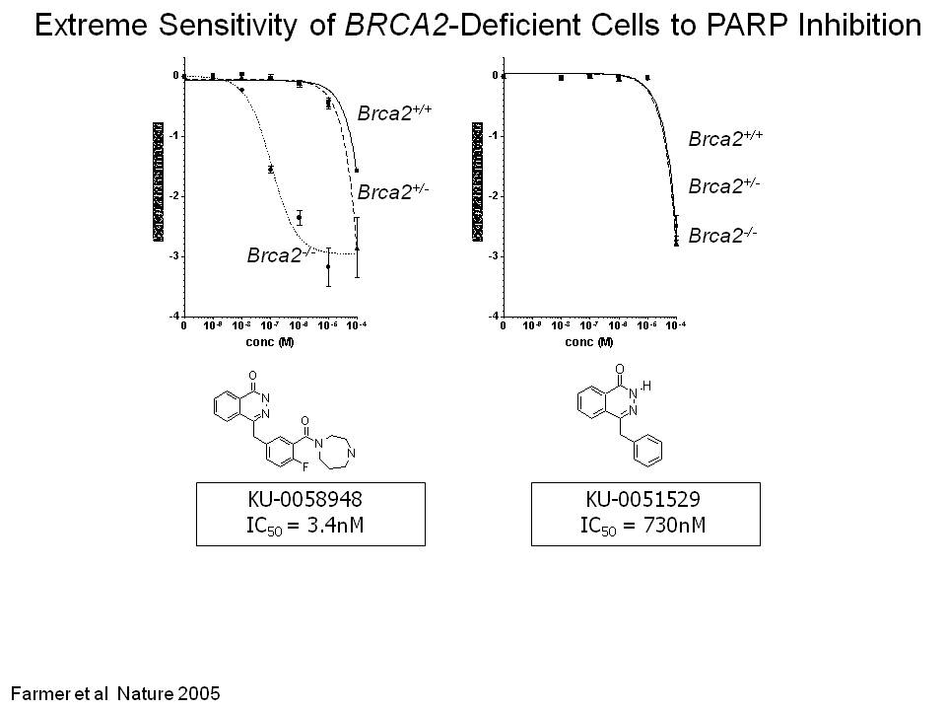
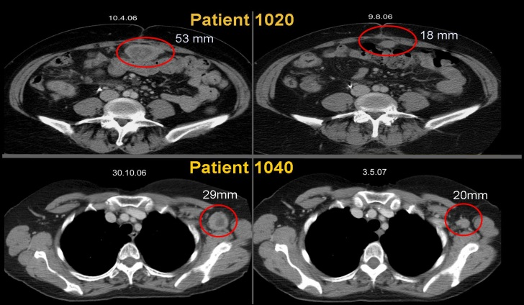
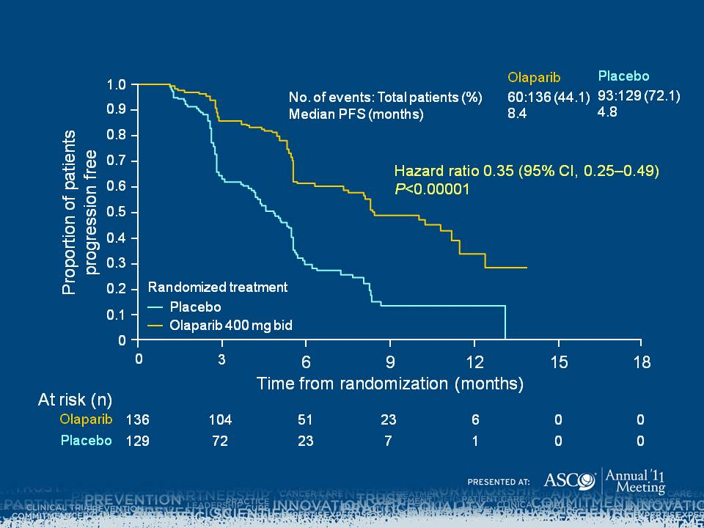
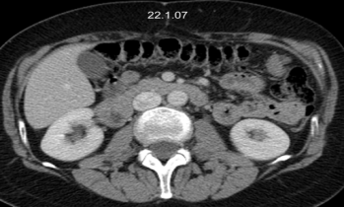
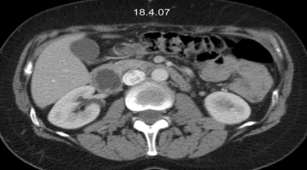
Single-Agent Trials PARP Inhibitors
Based on “tumour synthetic lethality” targeting cells with homologous recombination deficiency (HRD) – is this a new treatment for BRCA-mutation associated ovarian cancer?
Randomised Clinical
Trials (Phase II and III)
Preclinical
Early Clinical Trials
(Phase I, incl. IB)
PARP: poly(ADP) ribose polymerase
Phase I trial confirms excellent tolerance and expansion in 50 BRCA patients showed 46% response.
Randomised trial (maintenance therapy) showed marked PFS benefit
Exquisite preclinical efficacy of PARPi
This is nothing like chemotherapy
Farmer H, et al. Nature. 2005;434(7035):917-921.
Fong PC, et al. N Engl J Med. 2009; 361(2):123-134.
Fong PC, et al. J Clin Oncol. 2010; 28(15):2512-2519.
Ledermann JA, et al. N Engl J Med. 2012;366(15):1382-1392.

Slide 14
Randomised Maintenance Study 19: Design
Platinum-sensitive
relapsed patients with high-grade serous ovarian cancer in remission
(CR/PR)
N = 265
Randomisation 1:1
Olaparib
Oral 400mg bid
N = 136
Treat until progression
PFS Primary Endpoint
Placebo
Oral bid
N = 129
Initially BRCAm status known for only 36% of patients; subsequent analysis increased this to 96%
Ledermann JA, et al. N Engl J Med. 2012;366(15):1382-1392.
Notes:
Study 19 randomized 265 patients with platinum sensitive high grade serous ovarian cancer in a 1-to-1 fashion, with 136 receiving olaparib 400 mg twice daily and 129 receiving matching placebo.
The patients were treated until disease progression and followed for survival. The primary endpoint was PFS

Slide 15
Study 19 (ITT): Met PFS Primary Endpoint
 | Olaparib N = 136 | Placebo N = 129
Median (95%CI) | 8.4 mo (7.4, 11.5) | 4.8 mo (4.0, 5.5)
1.0
0.9
0.8
0.7
Probability
of
PFS
0.6
0.5
0.4
Olaparib
0.3
0.2
HR = 0.35 (95% CI: 0.25, 0.49) P<.00001
0.1
Placebo
0
0
3
6
9
12
15
Time From Randomisation, Months
Number at Risk
Olaparib | 136 | 106 | 53 | 24 | 7 | 0
Placebo | 129 | 72 | 24 | 7 | 1 | 0
Notes:
Study 19 met its primary endpoint for the overall population, demonstrating a statistically significant PFS benefit. The hazard ratio was 0.35, the median PFS was 8.4 months for olaparib and 4.8 months for placebo – a difference of 3.6months

Slide 16
BRCAm Status Summary
Known BRCAm status
254 (96%)
BRCAm
136 (51%)
Germline mutation
96 (36%)
Somatic mutation
18 (7%)
BRCA wt/VUS
118 (45%)
Tumour BRCAm but no germline sample
22 (8%)
Notes:
Using blood and archival tumour samples collected at baseline, we know the status of 96% of the patients in the study. In total , 51% patients had a BRCA mutation, which was a higher proportion than anticipated, and 45% had BRCA wild type or variant of uncertain significance.
The majority of patients (96/136) with a BRCA mutation are known to have a germline mutation. 18 patients are known to have a somatic BRCA mutation. The proportion of gBRCA to sBRCA is higher in this study compared to the literature ( 5:1 vs 3:1) suggesting there was some selection of known gBRCA patients for the study. 22 patients had a BRCA mutation in the tumour sample but there was no corresponding blood sample to check the germline status. I will summarise the data in these BRCA sub groups and later we will share the exploratory analyses we have conducted within the BRCAwt group

Slide 17
gBRCAm Patients Derive Greater PFS Benefit: 7.1 Months Median PFS Improvement
gBRCA
1.0
 | Olaparib (N = 53) | Placebo (N = 43)
Median (95%CI) | 11.2 mo (8.3, NC) | 4.1 mo (2.9, 5.1)
0.9
0.8
0.7
0.6
Probability of PFS
0.5
Olaparib
0.4
0.3
0.2
HR = 0.17 (95% CI: 0.09, 0.31) P<.00001
0.1
Placebo
0
0
3
6
9
12
15
Time From Randomization, Months
Number at Risk
Olaparib gBRCAm | 53 | 44 | 26 | 11 | 4 | 0
Placebo gBRCAm | 43 | 21 | 9 | 2 | 0 | 0
Ledermann J, et al. Lancet Oncol. 2014;15(8):852- 861.
Notes:
This is the KM curve for the 96 patients with a gBRCA mutation. The median PFS was extended to 11.2 months while the placebo patients had a median PFS of 4.1 months- an 83% reduction in the risk of disease progression or death for patients treated with olaparib compared with placebo in the maintenance setting. There was also a statistically significant improvement in the time to second subsequent therapy or death which is a surrogate for the time to second progression – with a Hazard ratio of 0.43. And there was no detriment in overall survival –the HR was 0.85 and median survival times were long in both groups: 32.9 months for olaparib 30.2m for placebo.

Slide 18
Overall Survival in Patients With BRCA Mutation
 | BRCA mut (n = 136)
 | Olaparib | Placebo
Deaths: total pts (%) | 37:74 (50.0) | 34:62 (54.8)
Median OS, months | 34.9 | 31.9
 | HR = 0.74 95% CI (0.46, 1.19) P = .208
1.0
0.9
0.8
0.7
0.6
Proportion of patients alive
0.5
0.4
0.3
0.2
Randomized treatment
Olaparib BCRAm
0.1
Placebo BRCAm
0
0
3
6
9
12
15
18
21
24
27
30
33
36
39
42
45
48
Number at risk
Time From Randomization, Months
Olaparib BRCAm
74
71
69
67
65
62
57
54
50
48
39
36
26
12
7
Placebo BRCAm
62
62
58
52
50
46
39
36
33
29
29
27
21
12
4
14/62 (22.6%) placebo patients switched to a PARP inhibitor
OS in BRCA WT patients: HR = 0.98; 95% CI, 0.62–1.55; P = .946
Median OS: olaparib, 24.5 months; placebo, 26.2 months
Ledermann JA, et al. J Clin Oncol. 2013;31(Suppl): Abstract 5505.

Slide 19
Randomized Trial of Olaparib As Maintenance Therapy in Platinum-Sensitive Sporadic Ovarian Cancer
Trial positive for primary endpoint (PFS). But overall survival impact less clear.
Does this reflect crossover (23%), or is there an impact of olaparib on subsequent response to chemo, and will this depend on BRCA mutation status?
What do we know about olaparib (and platinum) resistance?

Slide 20
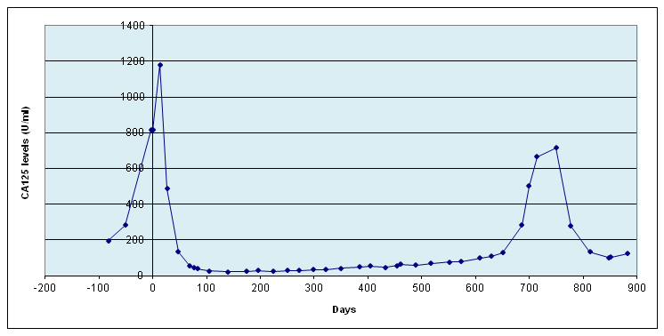
Chemosensitivity Post Olaparib in BRCA-Mutated Ovarian Cancer
For platinum-based treatment:
RECIST response in 19/48 (40%)
RECIST and/or CA-125 response in 26/53 (50%)
Median PFS: 22 weeks
Median OS: 45 weeks
Carbo. +C PLD
Olaparib
86% CA125 decline
98% CA-125 decline
ORR/OS significantly associated with interval since last (pre-olaparib) platinum
In 78 evaluable olaparib-treated patients, response to subsequent chemotherapy seen in 36% (24/67) by RECIST and in 45% (35/78) by CA125 and/or RECIST
Molecular analysis of tumor resected post-olaparib: No evidence of secondary mutations in 6 cases
Ang JE, et al. Clin Cancer Res. 2013;19(19):5485-5493.

Slide 21
PARP Inhibitors – What Are the Next Steps?
Anticipate registration of olaparib as maintenance therapy in germline BRCAm patients in 2015. Is there also a role in recurrent advanced disease?
Define activity in sporadic ovarian cancer and other cancers, eg, prostate
Develop robust predictive biomarker
Assess PARP inhibitors other than olaparib (rucaparib, niraparib, BMN-673)
Test novel combinations (with P13K or angiogenesis inhibitors, etc)
Monitor long-term toxicity
Understand mechanisms of PARPi resistance – probably multifactorial

Slide 22
Is There a Role for PARP Inhibitors in Recurrent BRCAm Ovarian Cancer?
Primary objective: compare efficacy of 2 dose levels of olaparib (300 mg and 400 mg bd) with liposomal doxorubicin
Efficacy of olaparib (400 mg bd) was as predicted, with response (RECIST/CA125) in 59% and median PFS of 8.8 m
PLD was more effective than anticipated (response 39%; median PFS 7.1 m); thus no significant difference in primary end-point
HR 0.88 P = .66
Overall, both treatments well tolerated (<10% discontinuation)
Patients:
Those with advanced BRCA1- or BRCA2-mutated ovarian cancer who had progressive or recurrent disease <12 months after previous platinum-based chemotherapy
Olaparib
200 mg bid in 28-day cycles
Olaparib
400 mg bid in 28-day cycles
Randomized
1:1:1
Liposomal DOX 50 mg/m² iv every 4 weeks
Further studies certainly warranted, including pts previously treated with PLD, eg Study 42, showing 31% response in 193 pts with platinum-resistant BRCAm ovarian cancer – Kaufman et al, JCO 2014
Sample size:
Total 90 (30 per arm)
Kaye SB, et al. J Clin Oncol. 2012;30(4):372-379.

Slide 23
Olaparib for Recurrent BRCAm Ovarian Cancer
Recent Developments
Ongoing pooled analysis of 300 patients who received olaparib in 6 studies involving BRCAm recurrent disease (273 with measurable disease)
All but one study nonrandomised
Data on subgroup of 137 patients who received ≥3 lines of chemo presented to FDA for accelerated approval
– response rate 34%; response duration 7.9 m
Accelerated Approval Granted

Slide 24
Status of Olaparib
– January 2015
Europe – approved as maintenance treatment for platinum-sensitive relapsed BRCAm ovarian cancer – patients in remission following platinum-based therapy
USA – approved as monotherapy for patients who have received ≥3 lines of chemotherapy
Not approved as maintenance therapy
Approval also for companion diagnostic (Myriad Genetics BRCA analysis CDx)

Slide 25
PARP Inhibitors – What Are the Next Steps?
The Cancer Genome Atlas, Molecular profiling of serous ovarian cancer, D. Levine 2011
What is the role of PARPi in sporadic ovarian cancer?
Not Homologous Recombination (HR) Deficient
HR Deficient

Slide 26
Patient Selection for Treatment with
PARP Inhibitors
Germline/somatic BRCA 1/2 mutation is “a standard of care”
Predictive biomarker for sporadic ovarian ca pts, possibilities include:
functional test for loss of HR (RAD 51 foci-formation)^{1,2}
molecular signature (gene array) ³
immunohistochemistry for BRCA 1 protein⁴
Circumstantially: • repeated response to platinum-based chemotherapy
• prolonged survival (>5 yrs)
• high-grade serous histology
1. Mukhopadhyay A, et al. Clin Cancer Res. 2010;16(8):2344-2351; 2. Graeser M, et al. Clin Cancer Res. 2010;16(24):6159-6168; 3. Konstantinopoulos PA, et al. J Clin Oncol. 2010;28(22):3555-3561; 4. Garg K, et al. Am J Surg Pathol. 2013;37(1):138-146.

Slide 27
Homologous Recombination Deficiency Assay
Myriad Genetics, presented at NCI/EORTC/AACR meeting 2014
DNA-based assay aimed at detecting HRD independent of cause, incorporating 3 algorithms:
Loss of heterozygosity (LOH)
Telomeric allelic imbalance (TAI)
Large-scale state transitions (LST)
HRD score is sum of LOH + TAI + LST scores
106 high-grade ovarian samples evaluated for HRD score and correlation with in vitro/in vivo PARPi (niraparib) sensitivity.
Initial results support further exploration of HRD score.
Haluska P, et al. Eur J Cancer. 2014;50(suppl 6): Abstract 214.

Slide 28
Single-Agent Activity for PARP Inhibitors in Ovarian Cancer
Drug | BRCA Mutation Positive |  |  | BRCA Wildtype and Unknown
 | n | % Resp | Resp duration | n | % Resp | Resp duration
Olaparib^{1,2,3} | > 100 (most plat resist) | 30%-60% | 7-10 m | 46 | 24% | 7 m
Rucaparib⁴ | 23 (all plat sens) | 61% | >6 m | 38 | 24% | >6 m
Niraparib⁵ | 20 (9 plat sens) | 45% | 11 m | 20 | 15% | 5 m
BMN 673⁶ | 28 (22 plat sens) | 68% | >6 m
* Preliminary genomic data for rucaparib | BRCA-like signature (LOH) | No BRCA–like signature
n | 25 | 13
resp % | 32% | 8%
1. Fong PC, et al. J Clin Oncol. 2010; 28(15):2512-2519.
2. Kaye SB, et al. J Clin Oncol. 2012;30(4):372-379.
3. Gelmon KA, et al. Lancet Oncol. 2011;12(9):852-861.
4. Swisher E, et al. . Eur J Cancer. 2014;50(suppl 6): Abstract 215.
5. Sandhu SK, et al. Lancet Oncol. 2013;14(9):882-892.
6. Ramanathan R, et al. Eur J Cancer. 2013;49(Suppl 3): Abstract LBA29.

Slide 29
Rational Targets in Ovarian Cancer - Agents Now in the Clinic
Inhibitors of:
VEGF and other angiogenic factors
PARP
P13K/AKT
MEK
2015 update on:
Single-agent data
Combination strategies

Slide 30
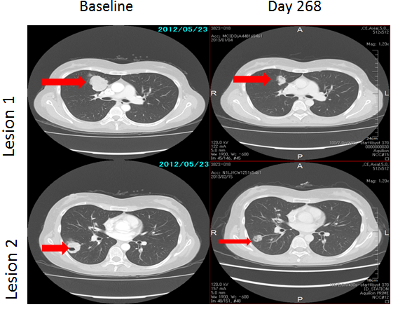
Single-Agent Trials – Other Agents
P13Kinase/AKT inhibitors
Mutations in 25%-30% clear cell/endometrial
Responses seen in phase I, eg, AZD 5363
MEK Inhibitors
RAS mutations in up to 50% low-grade serous
Single-agent efficacy seen with selumetinib
Randomised studies underway with more potent MEK inhibitors

Slide 31
Combination Strategies
Antiangiogenic / antiangiogenic
vertical / horizontal
Antiangiogenic / PARP inhibitor
cediranib / olaparib
PARP inhibitor / P13K inhibitor
P13K / MEK inhibitor
PI3K / chemotherapy
Not PARPi/chemotherapy!

Slide 32
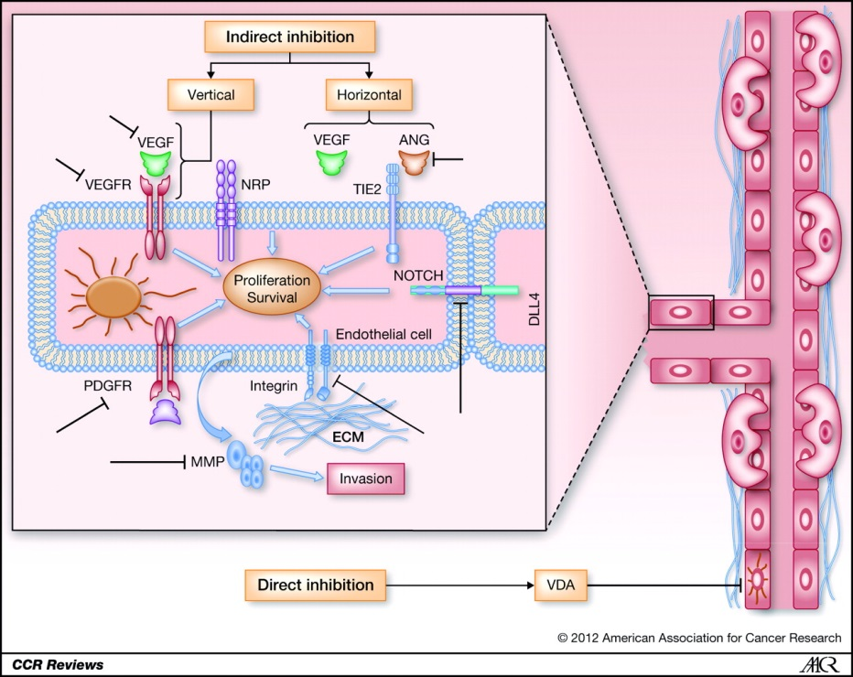
Combination of 2 Antiangiogenic Agents
a) vertical
ie, bevacizumab plus VEGFR-TKI, eg, sorafenib
Increased toxicity leads to dose modifications of both drugs, albeit with potential increased efficacy
(47% RR in 19 patients)
Lee JM, et al. Br J Cancer. 2010;102(3):495-499.
b) horizontal
ie, vascular disrupting agent (VDA) plus VEGF inhibitor
Fosbretabulin (CA4 pro-drug) plus bevacizumab. Potential synergy since VDA leads to blood-flow reduction and release of VEGFR
Randomised trial recently reported
Moreno Garcia V, et al. Clin Cancer Res. 2012;18(14):3750-3761.
Monk BJ, et al. Presented at: 15th Biennial Meeting of the International Gynecologic Cancer Society; November 8-11, 2014: Melbourne, Australia.

Slide 33
Bevacizumab/Fosbretabulin vs Bevacizumab
RANDOMISED
Response | Median PFS | Toxicity – G3 hypertension
28.2% | 4.8m | 19.6%
35.7% | 7.3m | 32.7%
 | HR 0.68 P = .049
Bevacizumab 15 mg/kg
q3w n = 54
Recurrent epithelial ovarian cancer
Bevacizumab 15 mg/kg
+ fosbretabulin 60 mg/kg
q3w n = 53
Conclusion: combination “warrants further evaluation in ovarian cancer”
Monk BJ, et al. Presented at: 15th Biennial Meeting of the International Gynecologic Cancer Society; November 8-11, 2014: Melbourne, Australia.

Slide 34
Antiangiogenic/PARP Inhibitors
Complementary targets/mechanisms of action
Potential enhancement of sensitivity to PARPi by increasing HRD through changes in oxygenation caused by antiangiogenic agent
Bevacizumab/olaparib – phase I trials confirmed feasibility
Cediranib/olaparib – randomised trial presented at ASCO 2014
Dean E, et al. Br J Cancer. 2012;106(3):468-474.
Liu JF, et al. Lancet Oncol. 2014;15(11):1207-1214.

Slide 35
Olaparib/Cediranib in Ovarian Cancer
Response (%) | Med PFS
22 (48%) Including 2 CR | 9 m (BRCAmut 16.5 m BRCA other 5.7 m)
35 (80%) Including 5 CR | 17.7m (BRCAmut 19.4 m BRCA other 16.5 m)
RANDOMISE
Olaparib
400 mg bd
N = 46
(BRCAm 24)
Platinum-sensitive relapsed patients n =90
(BRCA mut 47
BRCA wildtype 23
BRCA unknown 20
Olaparib
200 mg bd+ cediranib 30 mg od
n = 44
(BRCAm 23)
Main toxicity: h/t, diarrhoea, fatigue, leading to dose reduction n 34/44 (77%) and 4 pts discontinued treatment on olaparib/cediranib.
 | P value for PFS difference
BRCAmut | .16 (ns)
BRCA other | .0008
Liu JF, et al. Lancet Oncol. 2014;15(11):1207-1214.

Slide 36
Olaparib /Cediranib in Ovarian Cancer
Conclusions / concerns
An open-label study with no placebo may lead to bias
Nevertheless, most likely a significantly superior efficacy is seen for combination compared to olaparib alone, particularly in BRCA “other group”
At dose of 30 mg od, cediranib toxicity was considerable
Further studies of this combination are warranted both as maintenance therapy and for recurrent disease
Liu JF, et al. Lancet Oncol. 2014;15(11):1207-1214.

Slide 37
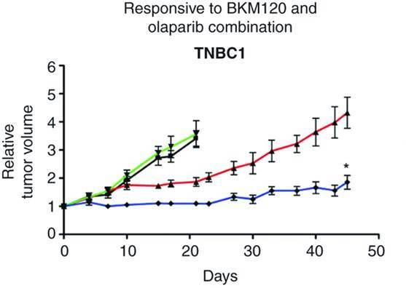
PARP Inhibitor Plus PI3K Inhibitor
With PI3K/AKT inhibitors
Preclinical data in TNBC cells demonstrate that P13K inhibition suppresses BRCA 1/2 expression and enhances sensitivity to PARP inhibition, partly through activation of ERK and transcription factor ETS1
Phase I trials now underway, including olaparib plus AZD5363
Initial data encouraging with no overlapping toxicity
Ibrahim YH, et al. Cancer Discov. 2012; 2(11):1036-1047.
Juvekar A, et al. Cancer Discov. 2012;2(11):1048-1063.
Rehman FL, et al. Cancer Discov. 2012;2(11):982-984.

Slide 38
MEK Inhibitor Plus P13K Inhibitor
Serous ovarian cancer comprises:
 | Precursor | Mutation | Chromosomal Instability | Response to Chemo | 5-Year Survival, %
Low- Grade | Serous borderline | KRAS, BRAF, HRAS | Low | Usually poor | 50-60
High- Grade | STIC | TP53 | High | Good but recurs | 40-50
In low-grade serous cancer:
Responses (PR18%) noted with single-agent MEK inhibitor (selumetinib), but will this be sufficient? (Farley J, et al. Lancet Oncol. 2013;14(2):134-140.)
Note experience with RAF inhibitors in melanoma
Preclinical data suggest resistance to RAS/RAF/MEK inhibition can be circumvented by P13K/AKT blockade.
Toxicity challenges: diarrhoea / skin rash /fatigue
Randomised studies may be necessary with appropriate dose modifications.

Slide 39
Looking Ahead…………
New targets leading to developments in:
Immunotherapy (checkpoint inhibitors)
Antibody-drug targeting

Slide 40
Looking Ahead – Early Results in Platinum-Resistant Ovarian Cancer
PDL-1¹
48/70 +ve for PDL1 expression (Hamanishi J, et al. Proc Natl Acad Sci U S A. 2007;27(9):3360-3365.)
20 patients with platinum-resistant disease treated with nivolumab (anti PDL1 antibody)
1/10 PR at 1 mg/kg
2/8 CR at 3 mg/kg, including 1 PR lasting 1 year and 1 patient with clear-cell carcinoma
NaPi2b²
Highly expressed in ovarian cancer
Controls transport of inorganic phosphate
Drug antibody conjugate comprising anti-NaPi2b with MMAE iv q3 weekly
7/17 PR (41%) in IHC-positive patients with platinum-resistant disease
Folate receptor³
Highly expressed in ovarian cancer
IMGN853 is a drug-antibody conjugate comprising anti-FRα with DM4 iv q 2 weekly
10/24 PR (42%) in platinum-resistant patients receiving >3.3 mg/kg
1. Hamanishi J, et al. J Clin Oncol. 2014;32(5S): Abstract 5511.
2. Burris HA, et al. J Clin Oncol. 2014;32(5S): Abstract 2504.
3. Moore KN, et al. J Clin Oncol. 2014;32(5S): Abstract 5571.

Slide 41
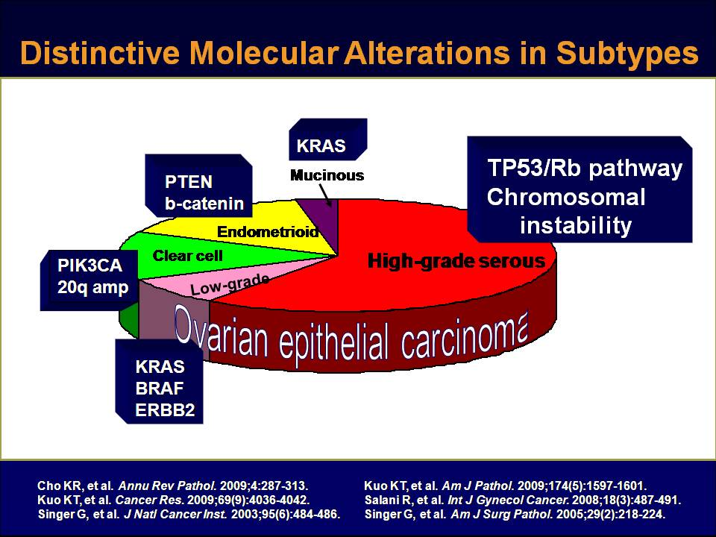
Targeted Therapy in Ovarian Cancer
Summary:
Real optimism surrounding new treatments for first time in 20 years
Antiangiogenesis and PARP inhibition are most promising, with positive randomized trial data
Other targeted approaches, particularly involving novel combinations, are being actively pursued
Patient selection, using robust predictive biomarkers, will be key to success

